Slide 1

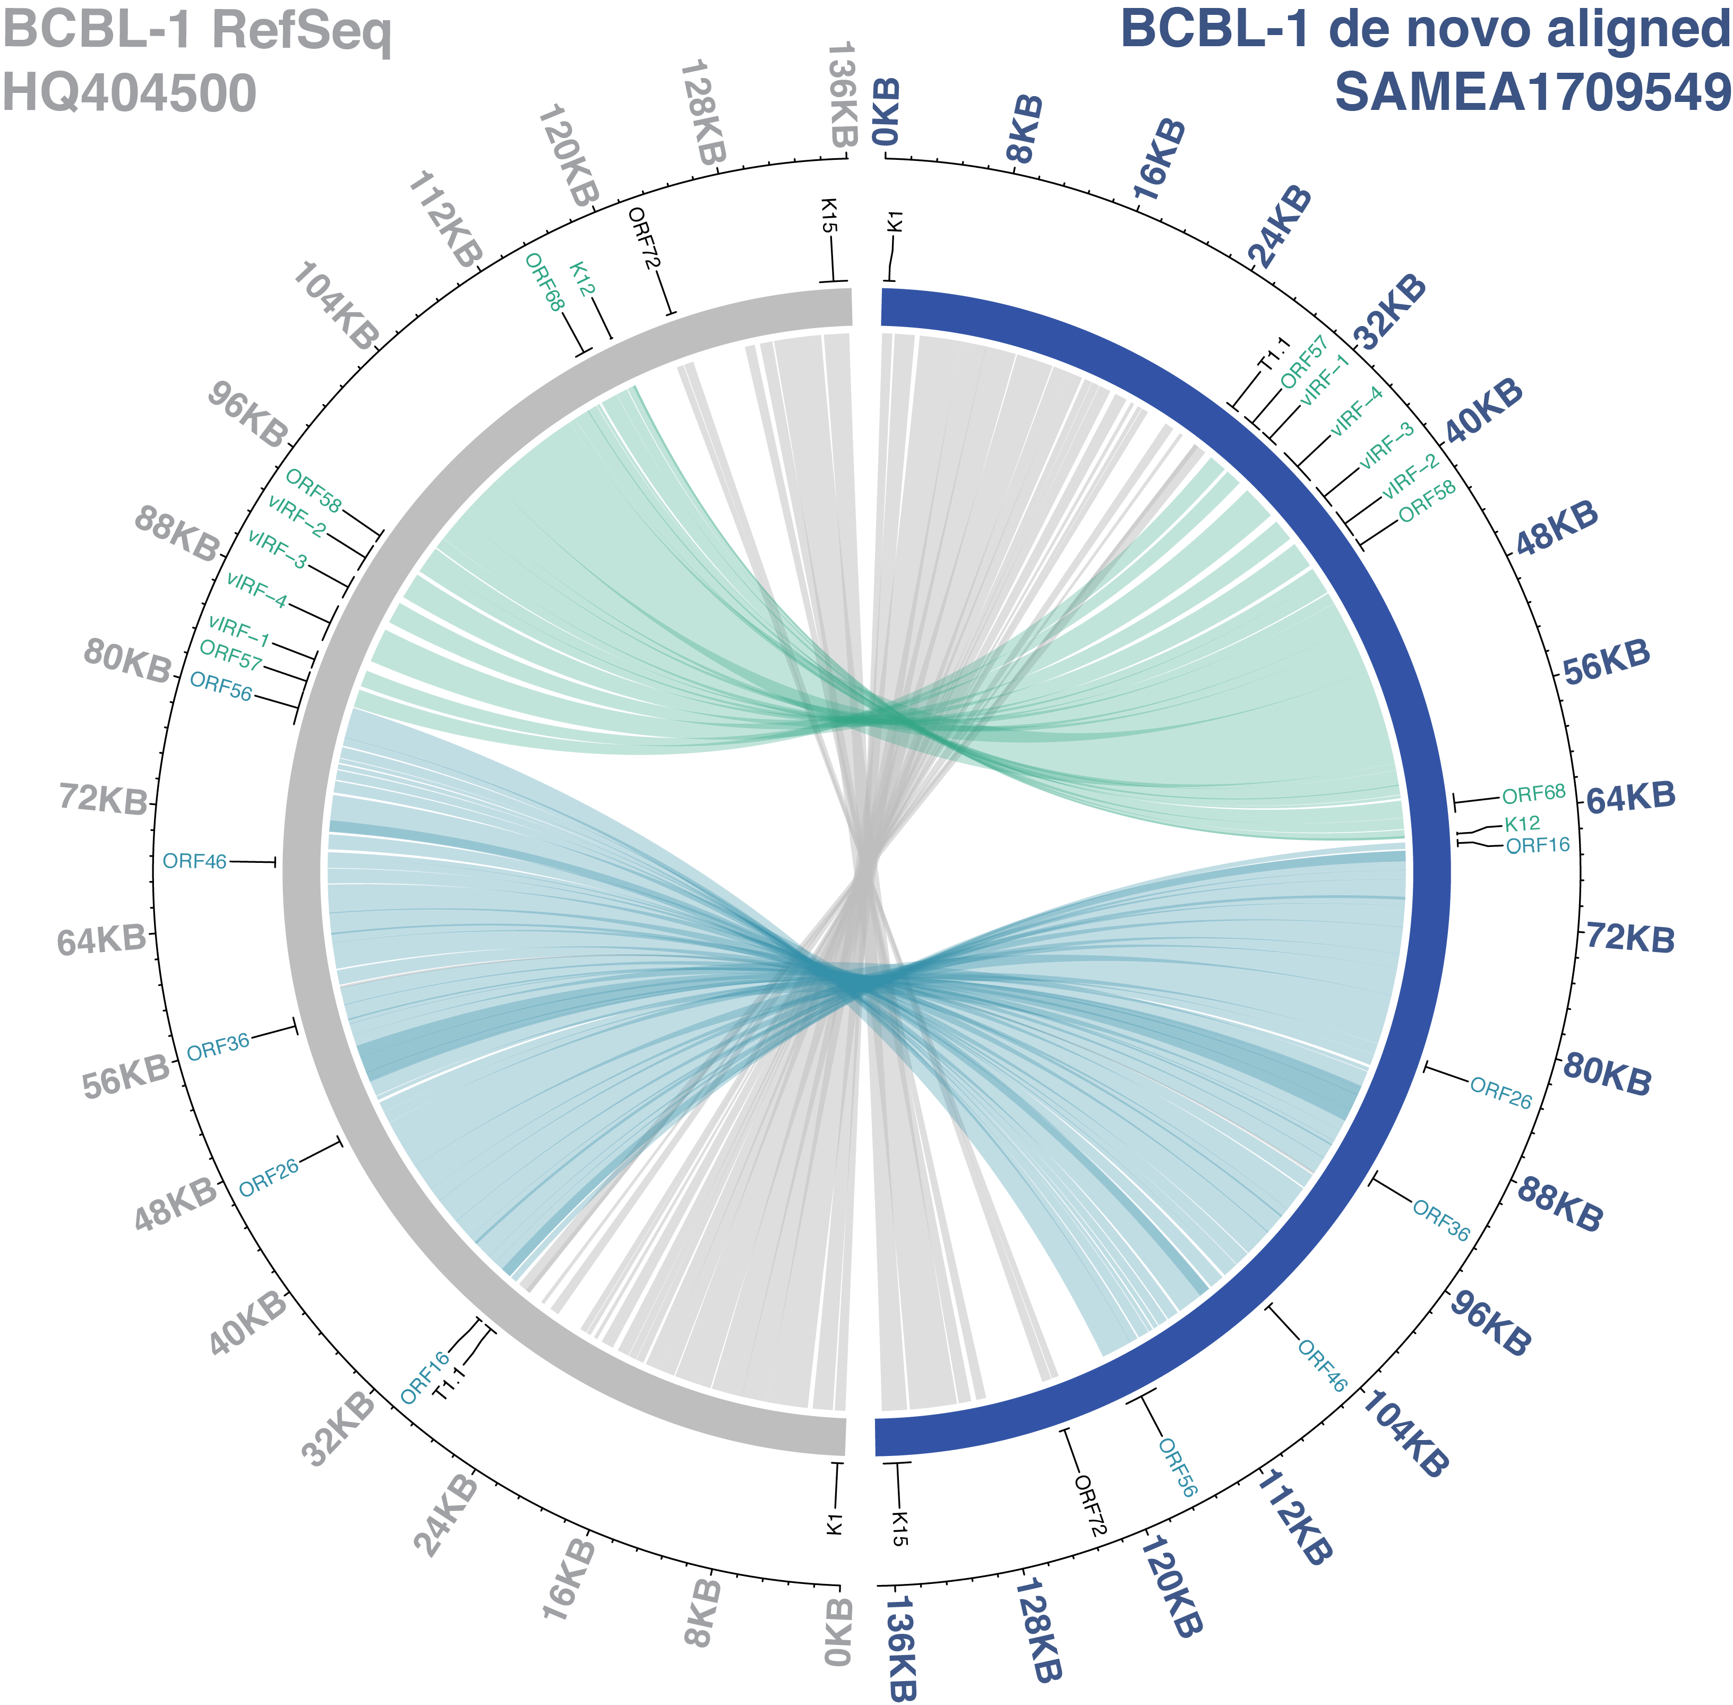
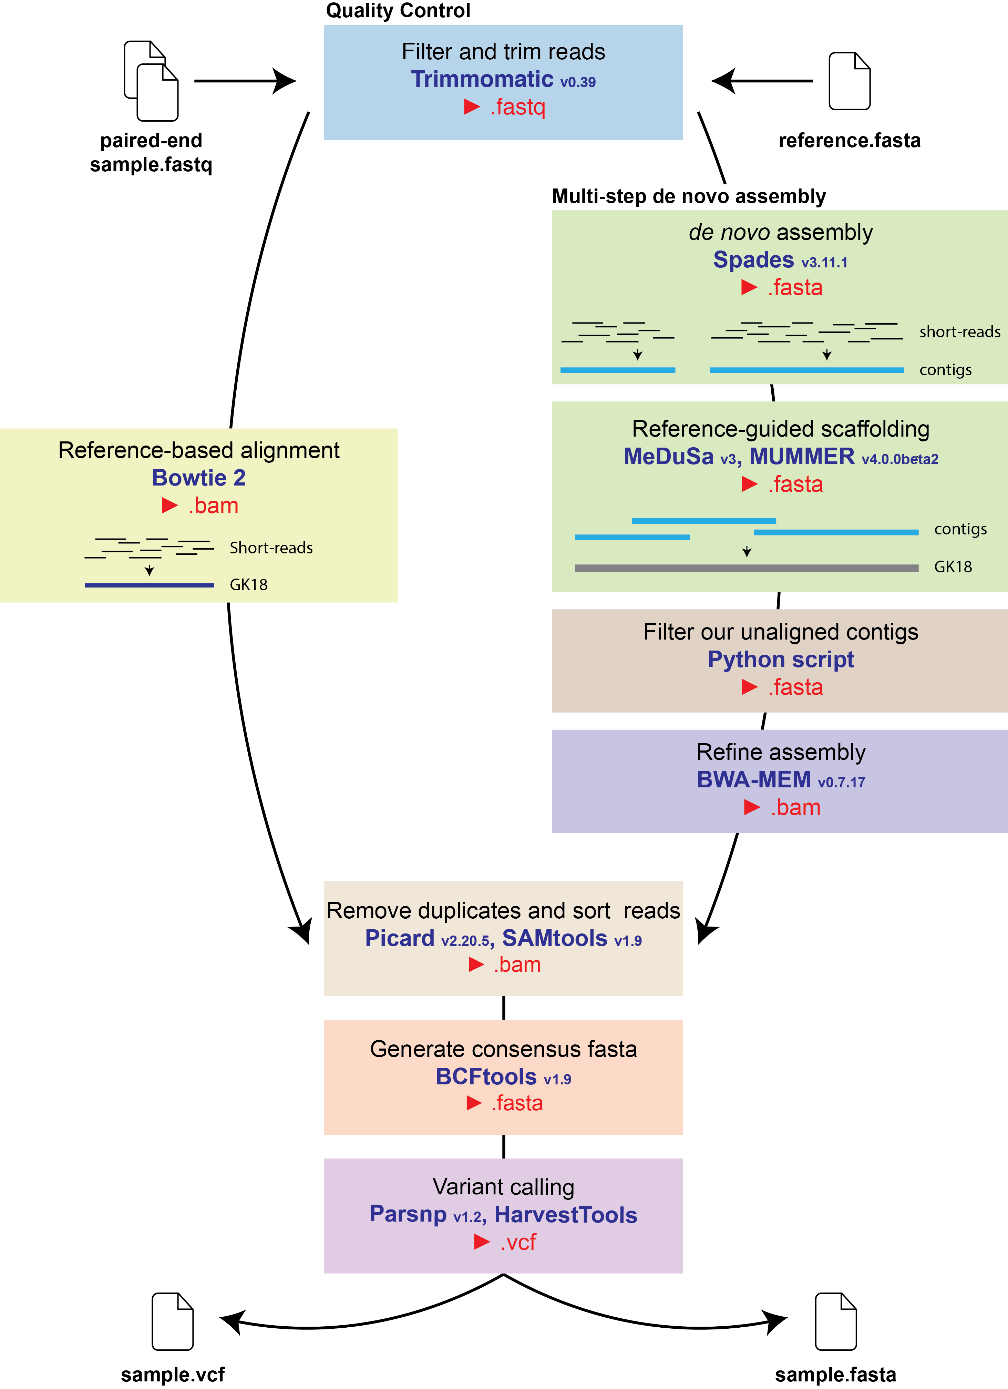
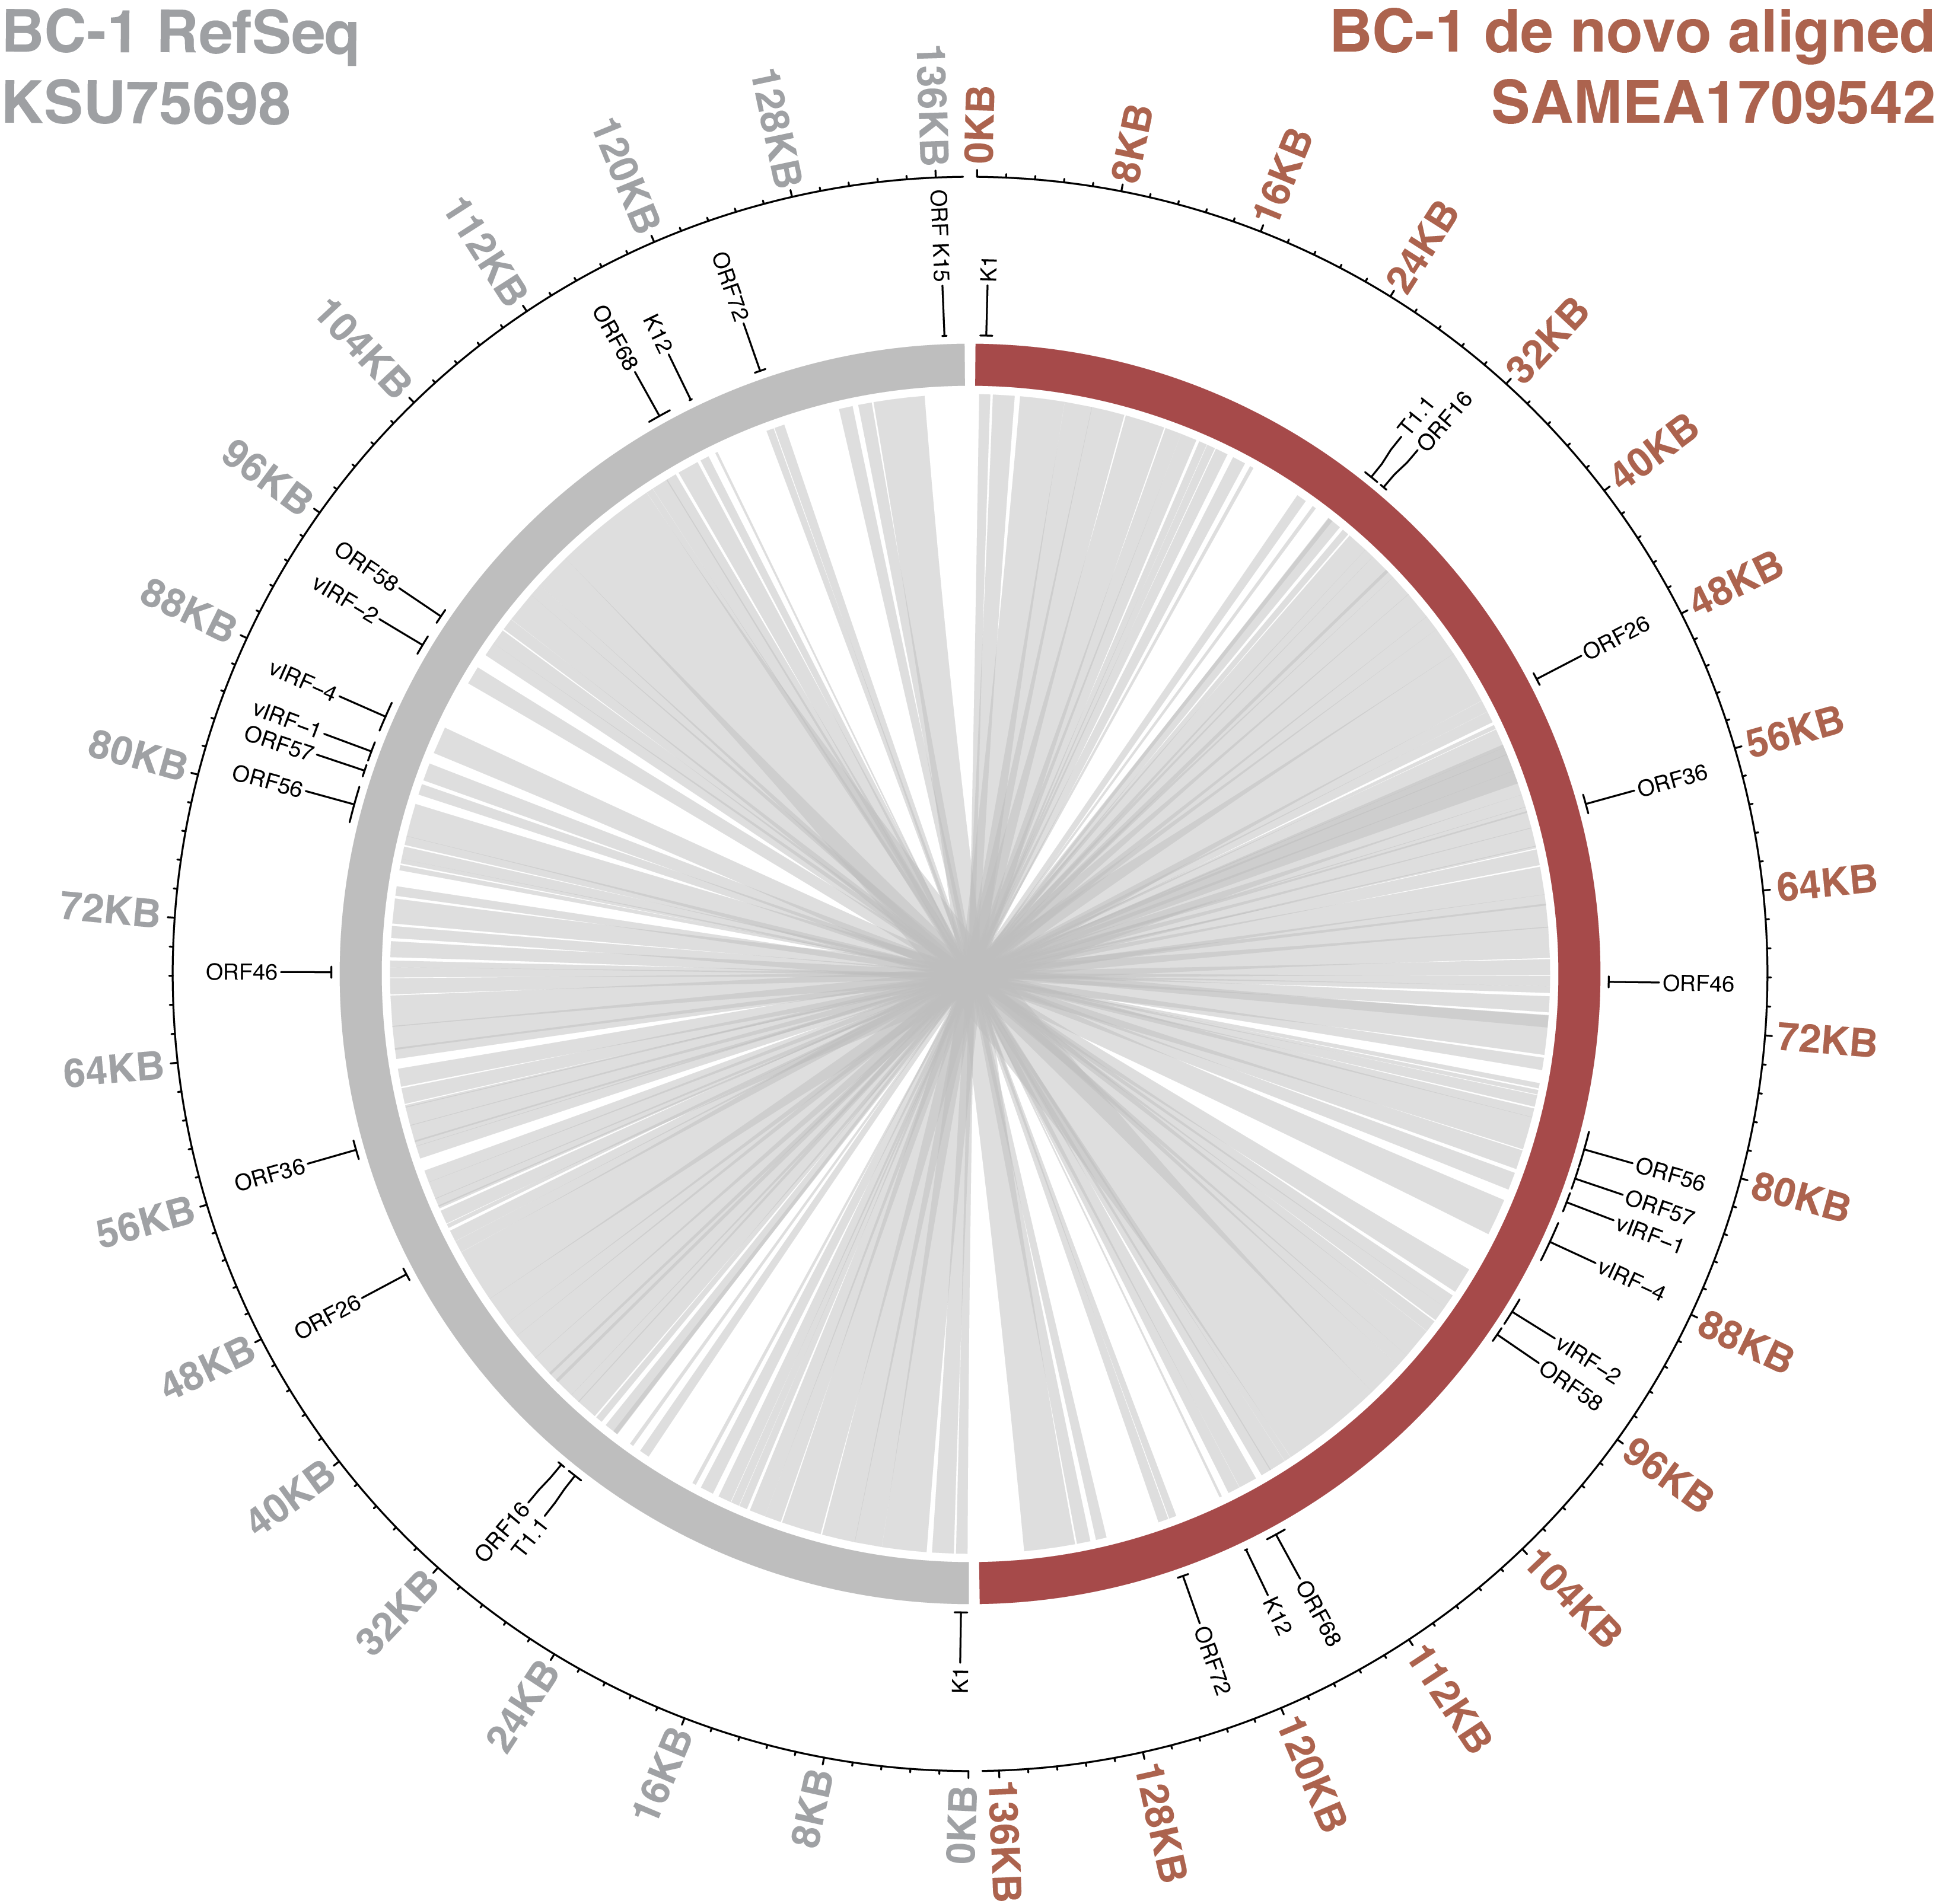
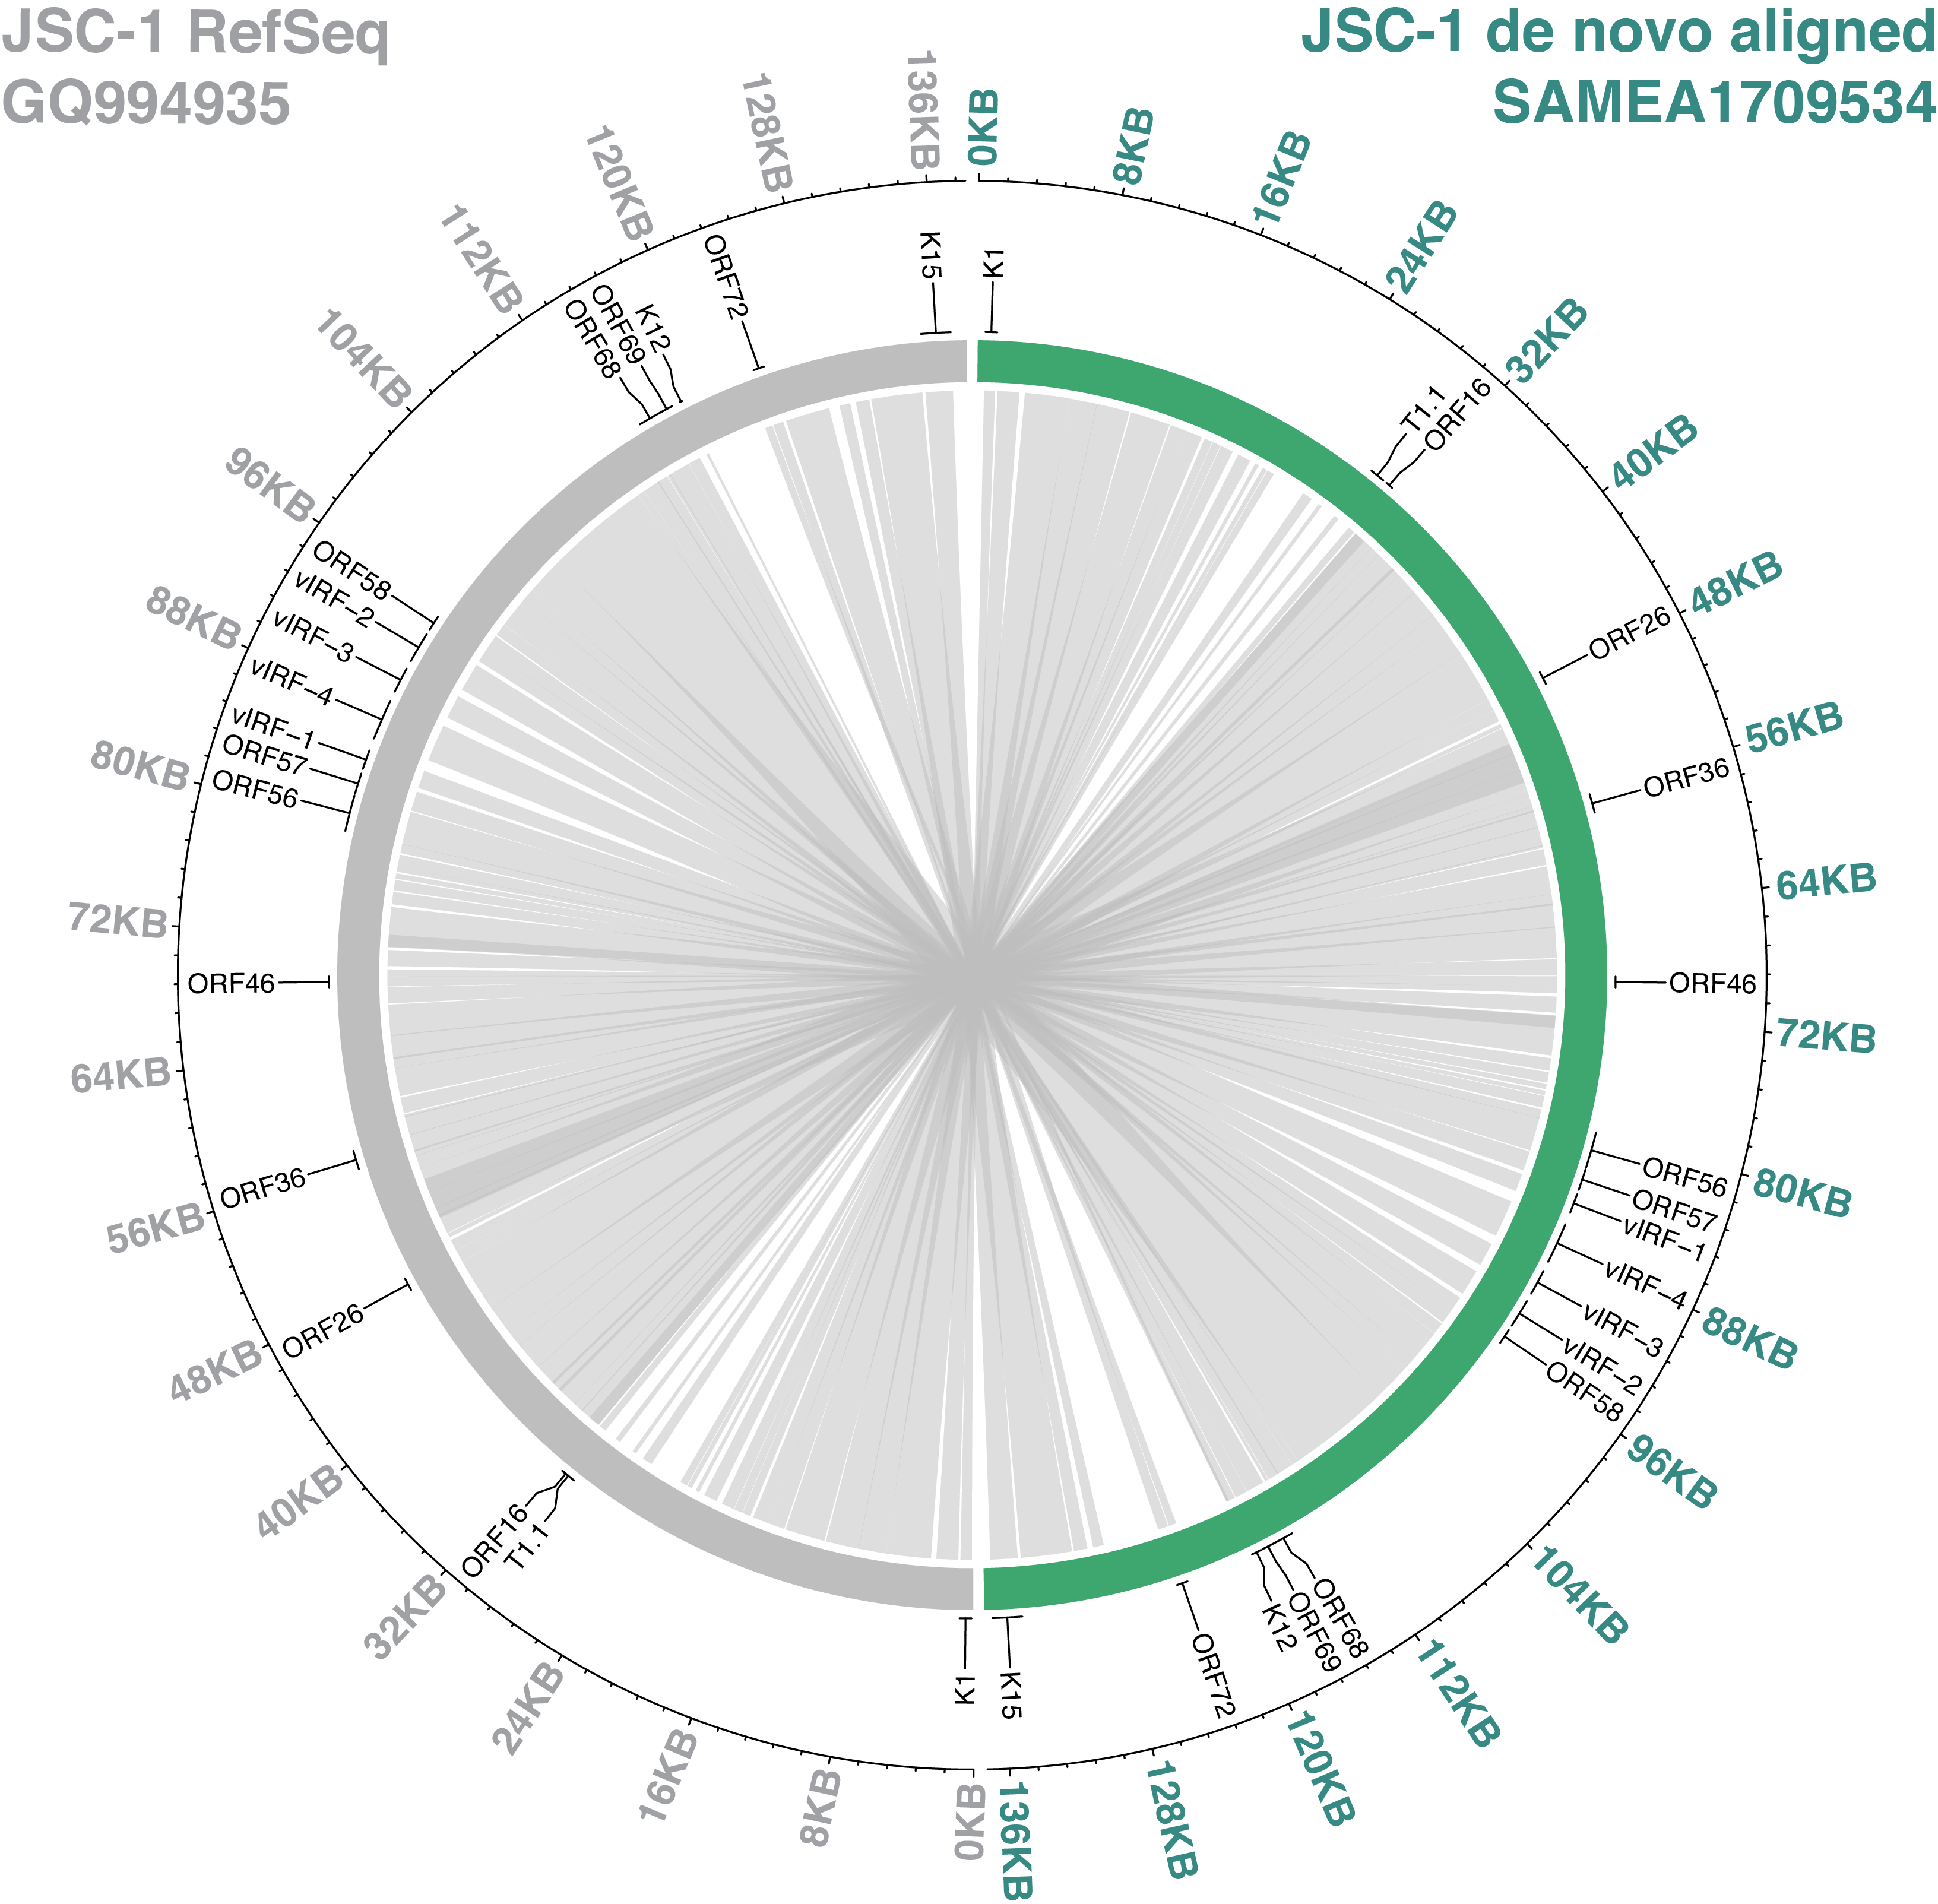
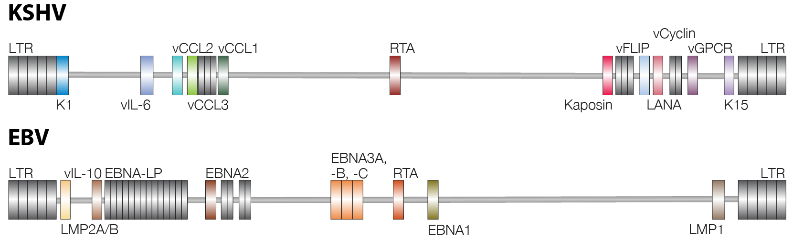
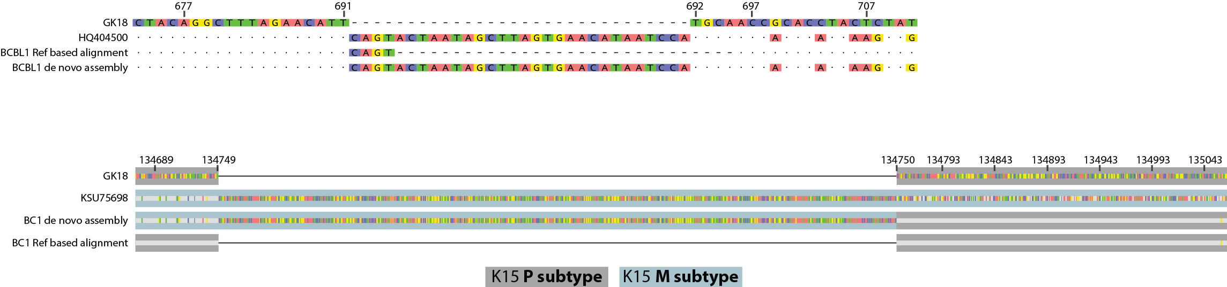

VDAP – Viral de novo Assembly, Variant Discovery and Annotation Pipeline
Elena M. Cornejo Castro¹, Sara Jones², Yunfan Fan³, Eneida L. Hatcher⁴, Nicholas C. Fisher¹, Vickie Marshall¹,
Denise Whitby¹
¹Viral Oncology Section, AIDS and Cancer Virus Program, Frederick National Laboratory for Cancer Research, Leidos Biomedical Research, Inc., Frederick, MD, USA; ²Clinical Research Directorate, Frederick National Laboratory for Cancer Research sponsored by the National Cancer Institute, Bethesda, MD, USA; ³Johns Hopkins University, Department of Biomedical Engineering, Baltimore, MD, USA; ⁴National Center for Biotechnology Information, National Institutes of Health, Bethesda, MD, USA
Introduction
Whole genome sequence analysis of γ-herpesviruses is a relatively new discipline.
Despite the role these viruses play in the pathogenesis of numerous malignancies, very few advances into the classification of isolates and identification of genetic determinants of viral pathogenesis have been made.
The genomes of γ-herpesviruses are relatively big (Fig.1). They have also acquired parts of the human genetic code, adding to the complexity of their analysis.
Further, the extent of recombination is poorly understood as the number and diversity of genomes available are limited.
We have developed a pipeline for the comparative analysis of herpesvirus genomes with the aim of providing researchers without advanced programming skills or resources to generate data that allows the comparative analysis of these genomes across studies.
This project was part of the May 2019 NCBI hackathon, led by Allissa Dillman.
Methods
Making use of free, open-source bioinformatics tools (Fig. 2) and recommended practices, we tested a suitable pipeline for the de novo assembly of herpesvirus.
KSHV sequencing reads for BC-1 (SAMEA1709542), BCBL-1 (SAMEA1709549) and JSC-1 (SAMEA1709534) were identified as a suitable test dataset as previously published consensus sequences are available (KSU75698, HQ404500, GQ994935 respectively).
Within Geneious Prime 2019.0.4 sequences generated from reference-based and de novo assembly pipelines were aligned to the reference sequence, GK18 (AF148805), by MAFFT v1.3.7 with the FFT-NS-2 algorithm.
We created CIRCOS plots between the GenBank reference sequences and the de novo aligned sequences for BCBL-1, BC-1 and JSC-1 with shinyCircos.
National Institutes of Health • Department of Health and Human Services
Results & Conclusions
VDAP is a de novo pipeline that utilizes free, open-source tools for quality control, assembly and variant calling (Fig. 2).
It outperformed reference-based alignment in resolving regions of interest (Fig. 4).
We are refining our pipeline to address and prevent inversions as seen in BCBL-1 (Fig. 3) and testing our pipeline on other datasets.
The combination of our pipeline and a docker container of software to run it provides researchers with minimal computational knowledge with the ability to perform assemblies of known viral sequencing reads on their local computer or other computational platforms such as Amazon Web Services.
A
B
C
Fig. 3: shinyCircos plots visualizing similarities and differences between de novo aligned and reference genomes: BCBL-1 (A), BC-1 (B) or JSC-1 (C).
Fig. 1: Schematic representation of γ-herpesvirus genomes. Highlighted genes are included for orientation on the genome, with repeat regions indicated as dark grey boxes. Adapted from Damania et al., 2014.
A
B
Fig. 4: de novo alignment resolves misalignments introduced in K1 (A) however it is not able to resolve all alignments as seen in K15 (B).
References
BWA-MEM v0.7.17: Li, H. Aligning sequence reads, clone sequences and assembly contigs with BWA-MEM. arXiv [q-bio.GN] (2013). Bowtie 2 v2.3.5.1: Langmead, B. & Salzberg, S. L. Fast gapped-read alignment with Bowtie 2. Nat. Methods 9, 357–359 (2012). Geneious Prime 2019.0.4 (https://www.geneious.com). MAFFT v1.3.7: Katoh K, Misawa K, Kuma K-i, Miyata T. MAFFT: a novel method for rapid multiple sequence alignment based on fast Fourier transform. Nucl Acids Res. 2002; 30(14):3059–66. doi:10.1093/nar/gkf436. Mauve v1.1.1: Darling AE, Mau B, Perna NT (2010) progressiveMauve: Multiple Genome Alignment with Gene Gain, Loss and Rearrangement. PLoS ONE 5(6): e11147. https://doi.org/10.1371/journal.pone.0011147. MeDuSa v3: Bosi, E. et al. MeDuSa: a multi-draft based scaffolder. Bioinformatics 31, 2443–2451 (2015). MUMmer v4.0.0beta2: Marçais, G. et al. MUMmer4: A fast and versatile genome alignment system. PLoS Comput. Biol. 14, e1005944 (2018). Parsnp v1.2: Treangen, T. J., Ondov, B. D., Koren, S. & Phillippy, A. M. The Harvest suite for rapid core-genome alignment and visualization of thousands of intraspecific microbial genomes. Genome Biol. 15, 524 (2014). SAMtools v1.9, BCFtools v1.9: Li, H. et al. The Sequence Alignment/Map format and SAMtools. Bioinformatics 25, 2078–2079 (2009). shinyCircos: Yiming Yu, Yidan Ouyang, and Wen Yao. shinyCircos: an R/Shiny application for interactive creation of Circos plot. Bioinformatics. 2017 Nov. 24. doi:10.1093/bioinformatics/btx763. Snakemake v5.5.4: Köster, Johannes and Rahmann, Sven. “Snakemake - A scalable bioinformatics workflow engine”. Bioinformatics 2012. Spades v3.11.1: Bankevich, A. et al. SPAdes: a new genome assembly algorithm and its applications to single-cell sequencing. J. Comput. Biol. 19, 455–477 (2012). Trimmomatic v0.39: Bolger, A. M., Lohse, M. & Usadel, B. Trimmomatic: a flexible trimmer for Illumina sequence data. Bioinformatics 30, 2114–2120 (2014). Picard v2.20.5: “Picard Toolkit.” 2019. Broad Institute, GitHub Repository. http://broadinstitute.github.io/picard/; Broad Institute. Docker v18.09.7: Boettiger (2015) Boettiger C. An introduction to Docker for reproducible research. ACM SIGOPS Operating Systems Review, Special Issue on Repeatability and Sharing of Experimental Artifacts. 2015;49(1):71–79.
Fig. 2: Comparison of reference-based alignment and de novo assembly pipeline VDAP. Tools with their versions used in the pipeline are indicated in blue with output file formats shown in red.
Funding
This project has been funded in whole or in part with federal funds from the National Cancer Institute, National Institutes of Health, under contract HHSN261200800001E and NCI Contract 75N91019D00024. The content of this publication does not necessarily reflect the views or policies of the Department of Health and Human Services, nor does mention of trade names, commercial products, or organizations imply endorsement by the U.S. Government.
DEPARTMENT OF HEALTH AND HUMAN SERVICES • National Institutes of Health • National Cancer Institute
Frederick National Laboratory is a Federally Funded Research and Development Center operated by Leidos Biomedical Research, Inc., for the National Cancer Institute
VDAP GitHub
Notes:
EBV, human homologs?
A block is defined as a region with continuous read coverage(http://shinycircos.ncpgr.cn/).

